Slide 1
Introduction to Neural Networks
Misty Nodine
March 23, 2016

Slide 2
Neural Networks
Supervised
✓
Semi-Supervised
✓
Unsupervised
✓
Regression
✓
Classification
✓

Slide 3
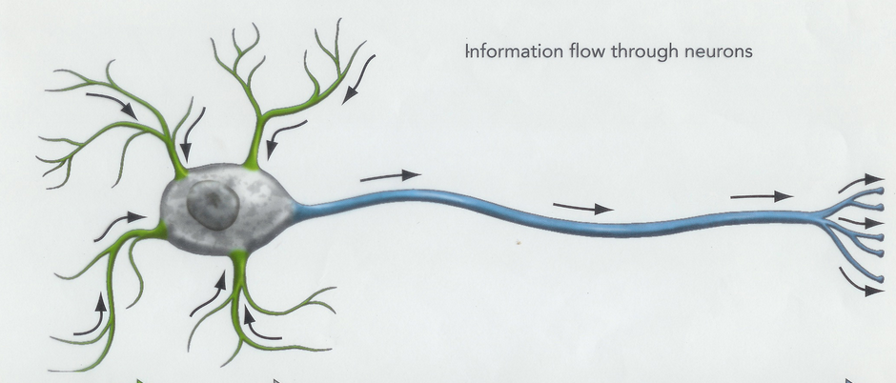
Basic Process of Neural Learning
Basic building block is modeled after a neuron
Collects many input signals either directly or that were output from other nodes
Aggregates those signals together, giving more weights to some signals than to others
Performs a function on the result of that aggregation to decide what to output
Outputs the result of the function
node
Function
Aggregation
(Weighted sum)
w₁
w₂
w₃
w₄
w₅
Notes:
Image taken from http://starklab.slu.edu/Physio/Neuron.jpg

Slide 4


Perceptrons
Perceptrons use a binary threshold unit over a weighted sum
Perceptron training algorithm:
Pick training cases using any policy that ensures that every training case will keep getting picked.
Update weights as follows:
If the output unit is correct, leave its weights alone.
If the output unit incorrectly outputs a zero, add the input vector to the weight vector.
If the output unit incorrectly outputs a 1, subtract the input vector from the weight vector.
Continue updating until all training cases are decided correctly.
Proven to converge as long as the training set is linearly separable.
node
w₁
w₂
w₃
w₄
w₅

Slide 5
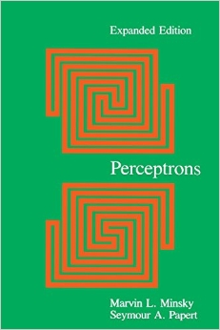
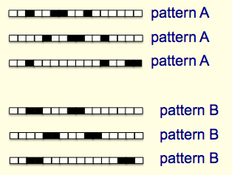
Perceptron Issues
Many criticisms of perceptrons – perhaps the most argued-over, controversial approach to Machine Learning in the 1980s.
Arguably the most impactful was Minsky and Papert’s ‘Group Invariance Theorem’.
The part of a Perceptron that learns cannot learn to recognize patterns despite transformations if the transformations form a group.
E.g. Pattern A and Pattern B are different, but no perceptron can be trained to tell them apart.
Notes:
AI Winter

Slide 6
Basic Process of Neural Learning
We want to build up nodes into networks
First convert raw data into features
Then use the features to make a decision, which is output
This means you have many layers of nodes in a neural network - an input layer, an output layer, and some number of ‘hidden layers’.
Another big issue with perceptrons relates to multiple layers of perceptrons.
There is no way to extend the perceptron training algorithm to work through a hidden layer.
output
features
data

Slide 7
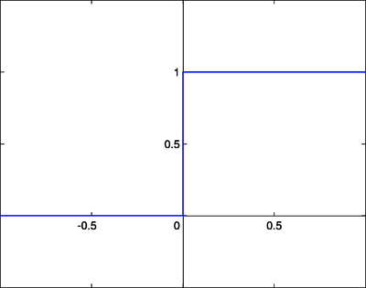
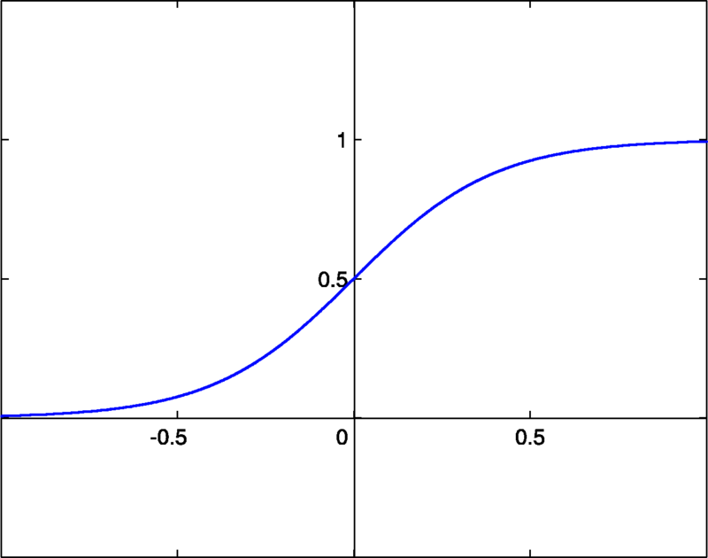
Neural Nets
Perceptrons
Neural Nets
Adjust the weights on the edges by adding or subtracting the error examples from the weights directly.
Use binary threshold neurons.
Adjust the weights on the edges using the gradient of the error. (gradient descent).
Prefer neuron types that are differentiable, so the gradient is convenient to compute. E.g. sigmoid neurons.

Slide 8
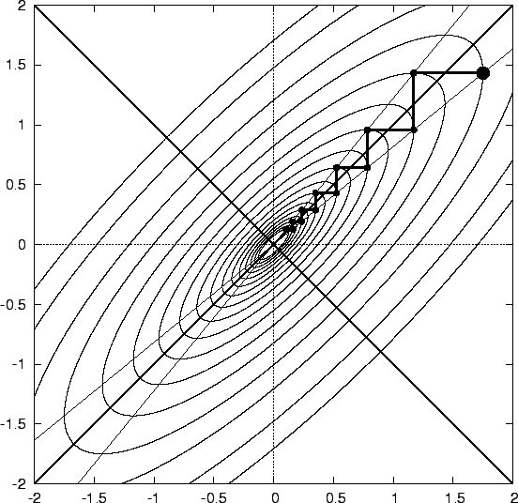
Backpropagation
Backpropagation is the first algorithm that led to practical neural network applications
Starting in the late 1900s, neural networks were used by the post office to route letters based on the zip code written on the envelope.
Backpropagation is a gradient descent algorithm.
start

Slide 9
Error Gradients
w₁
w₂
y
z
Σ
Σ
Error (P)
x
p₁
p₂
Notes:
Focus first on a single path neural net, two hidden layers. Need to compute the gradient of each of the weights.

Slide 10
The Gradient of the Error for w₂
Using the chain rule …
w₁
w₂
y
z
Σ
Σ
Error (P)
x
p₁
p₂
Notes:
Focus first on a single path neural net, two hidden layers. Need to compute the gradient of each of the weights.
α is the learning rate.

Slide 11
The Gradient of the Error for w₁
w₁
w₂
y
z
Σ
Σ
Error (P)
x
p₁
p₂
Notes:
Parts in red squares indicate shared computation between w_1 and w_2. So dP/dw_1 depends only on information local to the w_1 node (w_1, p_1, y) and something that was already computed in the next layer (dP/dP_2).

Slide 12
With Squared Error and Sigmoid Neurons
Here we are doing supervised learning, d is the correct output for the input training case.
Squared Error
Sigmoid

Slide 13
The Gradient of the Error for w₂
w₁
w₂
y
z
Σ
Σ
Error (P)
x
p₁
p₂
Notes:
Focus first on a single path neural net, two hidden layers. Need to compute the gradient of each of the weights.

Slide 14
The Gradient of the Error for w₁
w₁
w₂
y
z
Σ
Σ
Error (P)
x
p₁
p₂

Slide 15
Backpropagation
Loop through the training examples:
Perform forward propagation to compute the outputs of each neuron (x,y,z in previous examples).
Work backwards to update the weights (w₁, w₂ in previous examples).
w₁
w₂
Σ
y
Σ
z
Error (P)
x
W₁’
W₂’
x
Σ
Σ
Error (P)
p₁
p₂

Slide 16
Neural Network Architectures
By the late 1900s it was known that neural networks could approximate almost any function.
By 1969 it was known that neural networks could approximate exclusive-or.
‘Approximation by Superpositions of Sigmoidal Function’, Cybenko, 1989. (continuous functions)
But the fact that it is possible does not give us clues as to how to build a neural net to do this.
The “secret sauce” of a neural network is usually its architecture.
How many layers?
How many nodes per layer?
What kind of nodes?

Slide 17
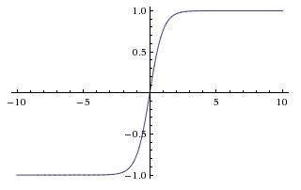
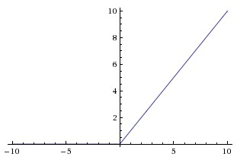
Variations on Neurons
Before we used sigmoid neurons and squared error function. You can swap these out at will.
Other useful types of neurons:
Linear
Rectified Linear
Often used with images
Hyperbolic Tangent
Stochastic Sigmoid
Like sigmoid, except the output is interpreted as a probability and a coin is flipped.

Slide 18

Softmax Function
Used for categorical outputs (e.g. multi-class classifiers) where the input is assumed to fit into a single category.
Output of a softmax node can be interpreted as the probability that the input is in the category represented by the output.
The output of a softmax is hard to compute, so this is often approximated using a hierarchical softmax.

Slide 19
Error Functions
Error functions are usually chosen based on the type of output node.
Choose based on how well the gradient is behaving.
Here, in the extremes, if you look at squared error, the error gradient is small. In the middle, the error gradient is large.
Want to make larger corrections when you are farther away.
Instead, have the error be computed in the log space, which makes the error function look linear.
Notes:
If you look at Andrew Ng’s ML class, he properly uses a logistic cross-entropy function with the sigmoid neurons.

Slide 20
Selecting the Error Function
Neuron | Error | Formula
Linear | Squared Error
Sigmoid | Binomial cross-entropy (log probability of a binomial distribution)
Softmax | Categorical cross-entropy (log probability of a multinomial distribution with one trial)

Slide 21
Some Terminology
Feed-Forward Neural Network
The activities in each layer are a function of the activities in some layer ‘below’.
There are no cycles.
Layered
A feed-forward network arranged into layers of neurons.
Skip Edge
If a network is arranged in layers, this would be an edge that bypasses one or more layers.
Deep Neural Network
A neural network that has more than one hidden layer.
output
hidden
input

Slide 22
A Practical Example: Words
Words, one hot representation
You shall know the truth, and the truth shall
make you free.
Distributed representation of words
Want to distribute this representation across a smaller set of features.
Mikolov et.al. 2013. “Distributed Representations of Words and Phrases and their Compositionality”.
1
2
3
4
5
6
4
5
2
7
1
8
0 | 0 | 0 | 0 | 1 | 0 | 0 | 0

Slide 23
Selecting Word and Context
How to find distributed representations?
Context in which word is used
Similar words will be in similar contexts
Train for a generative model
you shall know the
shall know the truth
know the truth and
…
Train in a more embedded context
you shall know the truth
shall know the truth and
know the truth and the
…

Slide 24
Word2vec CBOW Architecture
Softmax output layer
0
0
0
0
1
0
0
0
One hot
representation
Hidden layer
0
1
0
0
0
0
0
0
0
0
1
0
0
0
0
0
0
0
0
1
0
0
0
0
One hot
representation
One hot
representation
One hot
representation

Slide 25
Training Example
truth
Softmax output
0
0
0
0
1
0
0
0
One hot
representation
Hidden layer (sum)
Distributed
representation
0
1
0
0
0
0
0
0
0
0
1
0
0
0
0
0
0
0
0
1
0
0
0
0
shall
know
the

Slide 26
Two Architectures
CBOW (Continuous Bag of Words)
Context words are input
Preserve the order of the context words from the input text
Hidden layer can be either the sum of the input words or the mean of the input words
Output of the softmax node is the log likelihood for each word, given the context.
Skip-Gram
The word you are interested is the input
One softmax output node per word in the context

Slide 27
Demo …

